Slide 1
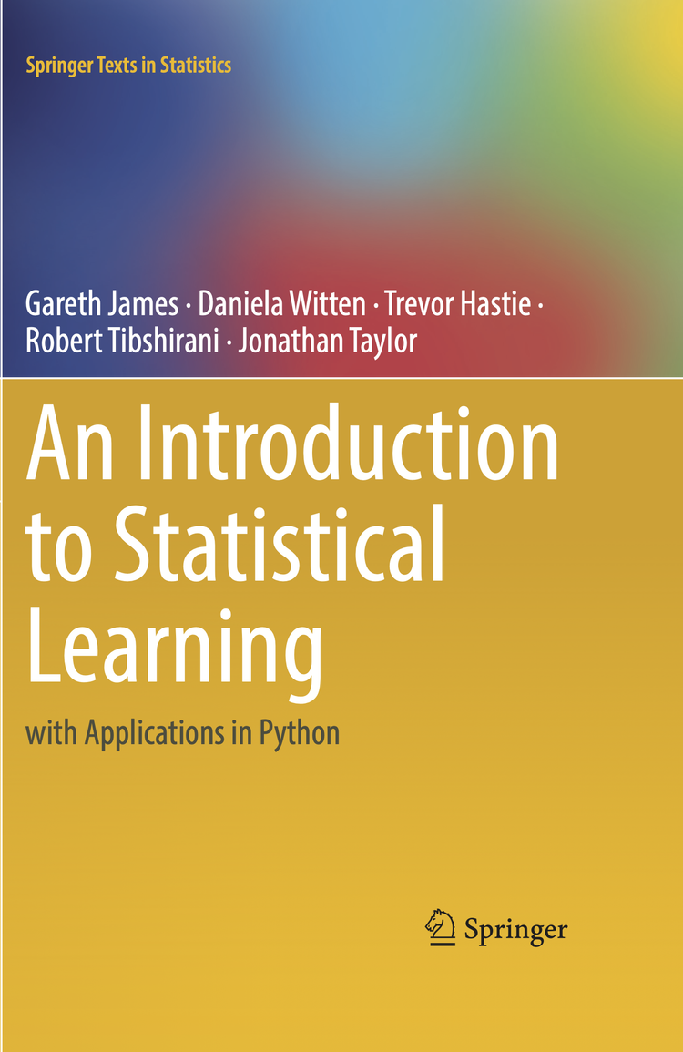
Exercises ISLR – Ch.2
Marcelo Previato Simoes Nº 2367070
18/08/2025

Slide 2

Conceptual
Exercises: 4, 7

Slide 3

Exercise 4a) Classification Problem
Prediction on Fraud Detection in Banking Transaction
Y = fraud classification {0 = legitimate, 1 = fraudulent}
X = multiple transaction information including:
Transation features: Time, Amount, Amount Deviation, Velocity, Device, Device Deviation…
Customer features: Region, Region Mismatch, Age, Income, Regularity of transactions…
Recipient features: Region, New x Usual Recipient...

Slide 4

Exercise 4b) Regression Problem
Inference on the Impact of Remote Work in Wealth
Y = wealth $ (in general, ln(wealth))
X = multiple information including:
Variable of Interest: Remote Work (0 = No, 1 = Yes) → inference about impact (causal inference)
Demographics Controls: Region, State, Urban x Rural, Age, Age^2, Race, Gender…
Experience Controls: Years of Education, Degree, Course Category, Work Tenure, Public x Private Sector, Industry…

Slide 5

Exercise 4c) Cluster Analysis
Prediction on Customer Segmentation in Grocery Purchase
Y = Customer Category (e.g. Healthy Bulk, Healthy Light, Conventional Bulk, Conventional Light)
X = multiple customer information:
Product Selections: share of healthy food, share of processed food, diversity of SKUs, changes...
Quantity Related: average basket size, average basket value, proportion of large transactions, weight of purchase, % of large size itens, % of combo itens

Slide 6
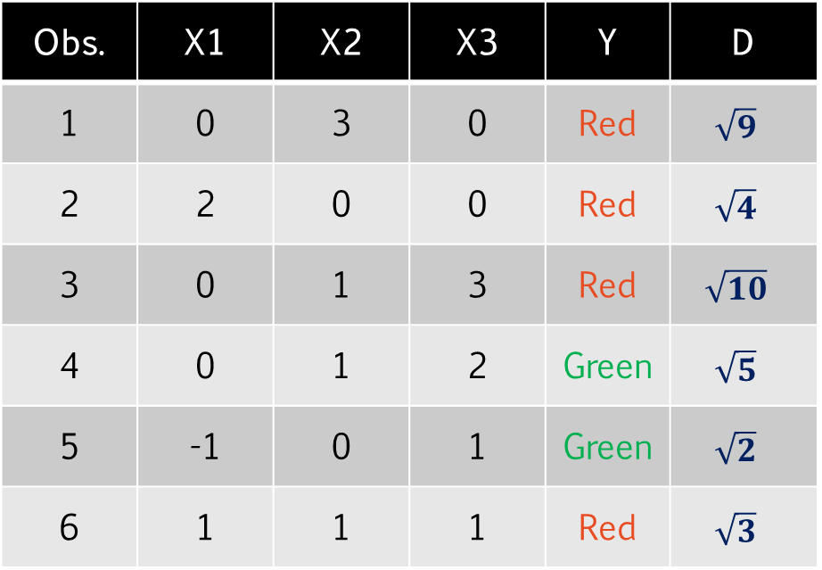
Exercise 7) Classification KNN
K = 1 → obs 5
P(Green) = 1 → Green
K = 3 → obs 5,6,2
P(Red) = 2/3 → Red
Non-linear → smaller K, since it is more flexible and able to capture the non linearity
Obs. | X1 | X2 | X3 | Y | D
1 | 0 | 3 | 0 | Red | $$\sqrt{9}$$
2 | 2 | 0 | 0 | Red | $$\sqrt{4}$$
3 | 0 | 1 | 3 | Red | $$\sqrt{10}$$
4 | 0 | 1 | 2 | Green | $$\sqrt{5}$$
5 | -1 | 0 | 1 | Green | $$\sqrt{2}$$
6 | 1 | 1 | 1 | Red | $$\sqrt{3}$$

Slide 7

Applied
Exercises 10

Slide 8

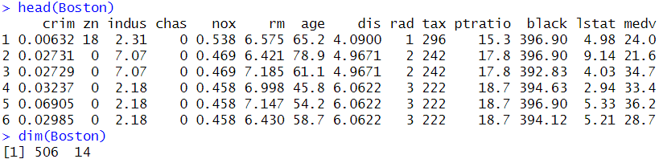
Exercise 10a) Boston Suburbs Info
Greater Boston Residence Information
N = 506 observations
X = 14 variables (normally Medv is the dependent variable)

Slide 9
Exercise 10b) Covariates
X | Explanation
crim | per capita crime rate per town
zn | proportion of residential land zoned for lots over 25,000 sq.ft.
ind | proportion of non-retail business acres per town (industrial)
chas | Charles river bound
nox | nitrogen oxides concentration (pollution)
rm | average number of rooms per dwelling
age | proportion of owner-occupied units built prior to 1940 (antique)
dis | weighted mean of distances to five Boston employment centres.
rad | index of accessibility to radial highways
tax | full-value property-tax rate
ptratio | pupil-teacher ratio by town.
black | Index based on proportion of blacks by town
lstat | lower status of the population
medv | median value of owner-occupied homes

Slide 10
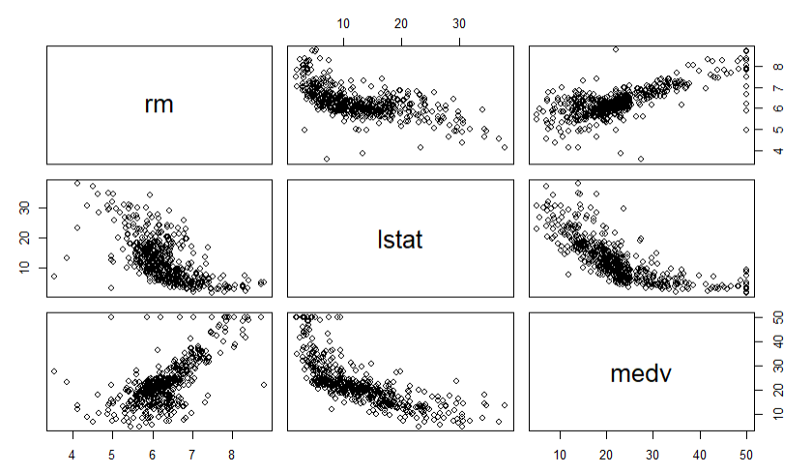
Exercise 10c) Scatterplots
Cov(rm, medv) +
The higher the number of rooms, the higher value of the residence
Cov(lstart, medv) -
The higher the share of low status people, the lower the value of the residence

Slide 11
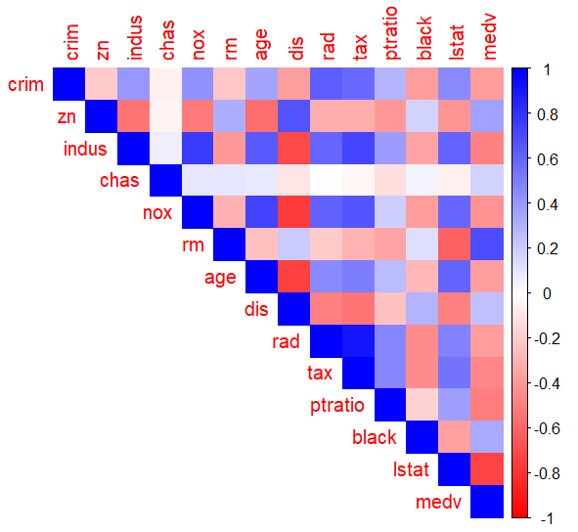
Exercise 10d) Correlations
Positive: indus, rad, nox → areas near industries and roads tend to have higher crime rate
Negative: dis, black, medv → areas with less expensive residences, distant and with black residences tend to have lower crime rate

Slide 12
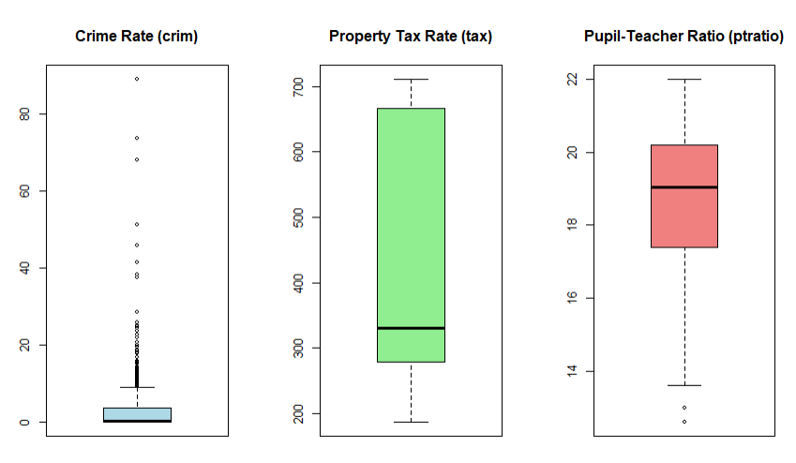
Exercise 10e) High values

Slide 13
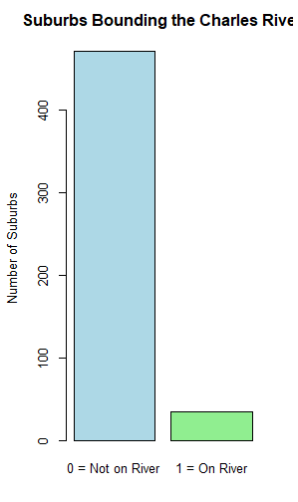
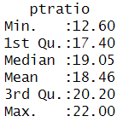

Exercise 10f,g) Descriptive
35 suburbs by Charles river
Median: 19.05

Slide 14
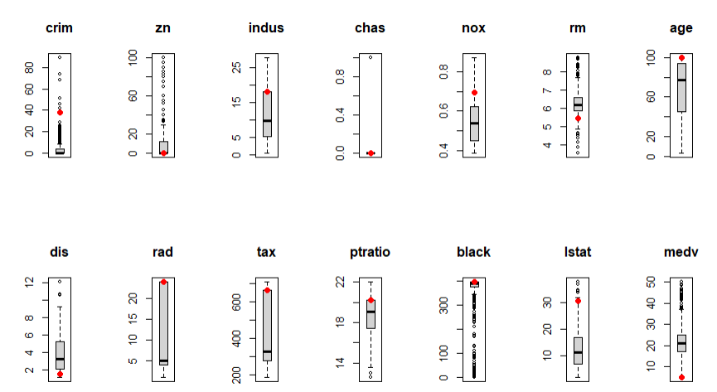
Exercise 10h) Lowest medv suburb
Suburb 399
Violent
Small lots
Industrial
Polluted
Old buildings
Near roads
High tax
More black

Slide 15
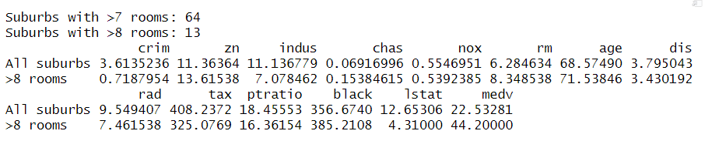
Exercise 10i) Larger residences
Suburbs witn >8 rooms are twice as expensive as the entire database

